Slide 1

LEAFLOGIC
Plant Growth
Intelligence & Decision
Platform
Grow smarter by understanding your plant's history.
SPECIES-AWARE
CONTEXTUAL INSIGHTS
PROJECT PRESENTERS :
KARTHKEYAN P
PRANAVE PADMANABHAN
VINESH AYYAPPAN S P

Slide 2

PROBLEM
Plant care is often managed through memory, random notes and guesswork.
Inconsistent watering
Sunlight mismatch
Temperature or humidity issues
Late pest or disease detection
No organized growth history
Guess-based care decisions
Core problem statement
Many plant owners struggle to understand why their plants are not growing well.
LeafLogic • Plant Growth Intelligence & Decision Platform

Slide 3
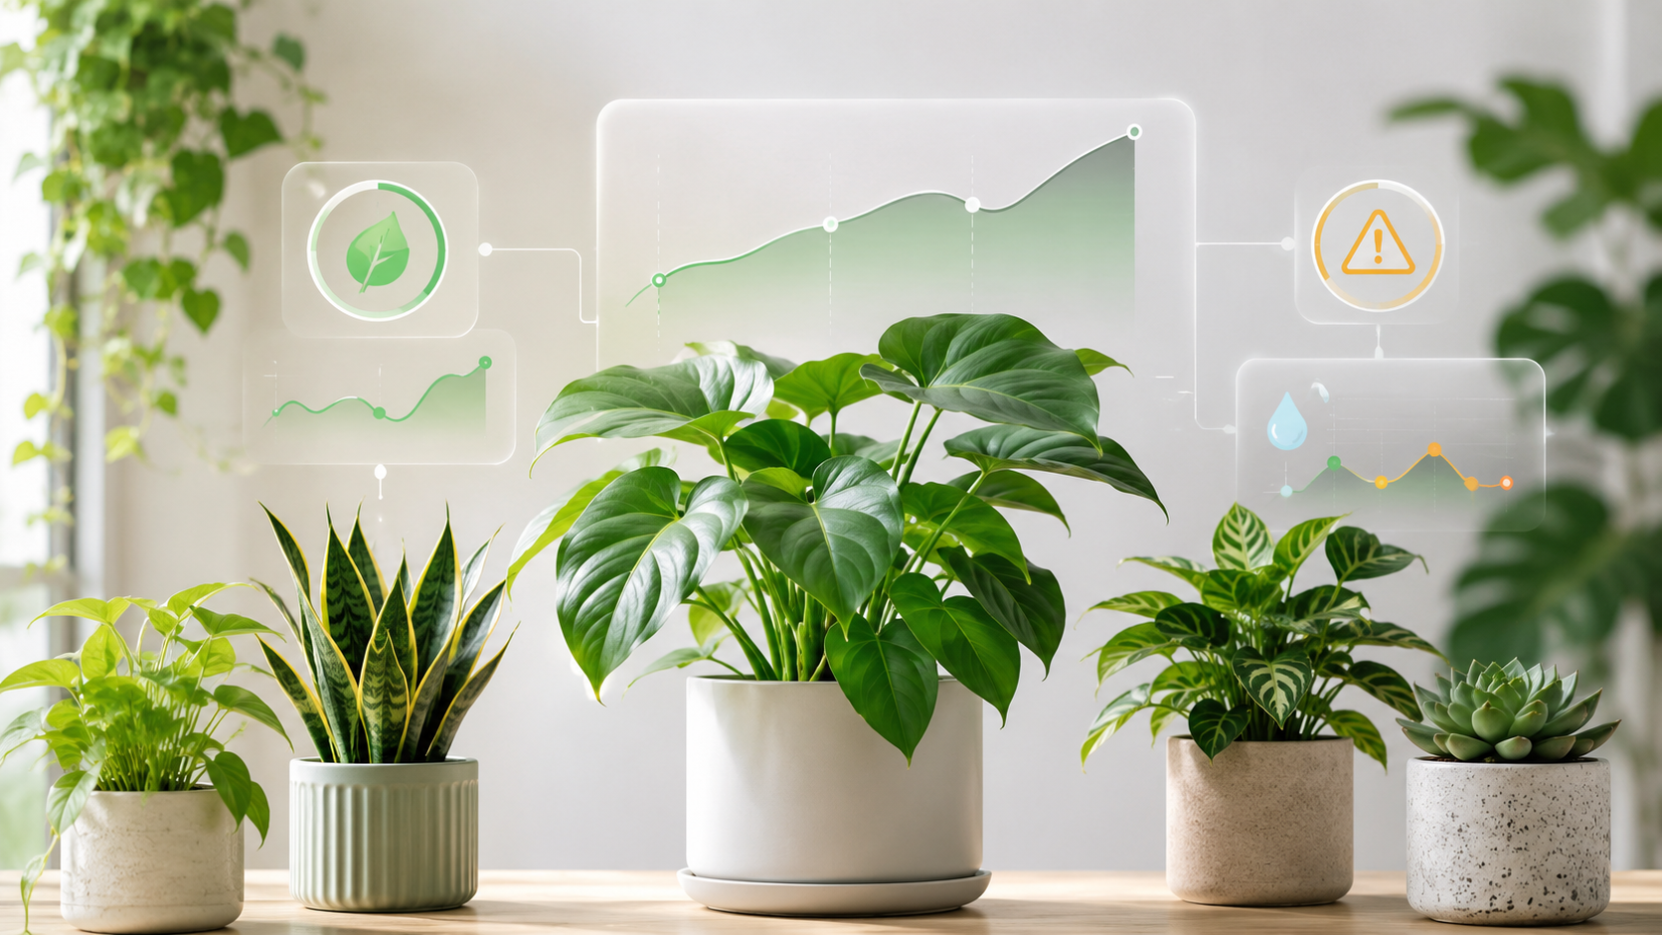
PROPOSED SOLUTION
LeafLogic turns longitudinal plant data into actionable intelligence.
Users create plant profiles, log repeated care and growth data, then generate health scores, trend analysis, alerts and recommendations.
Structured logging
Species guidance
Health scoring
A multi-factor intelligence layer connects history, context and risk.
LeafLogic • Plant Growth Intelligence & Decision Platform

Slide 4
KEY FEATURES
A complete digital system for managing plant history.
Authentication
Plant profiles
Species library
Signup, login, JWT, password hashing and protected pages
Name, species, location, soil, pot size, planted date and notes
Predefined care ranges and tips for common plants
Plant logs
Analysis dashboard
Recommendations
Growth, care, environment, health and optional images
Health score, weekly summary, growth trends and risk checks
Context-aware observations, likely causes and prioritized actions
LeafLogic • Plant Growth Intelligence & Decision Platform

Slide 5

HOW IT WORKS
A connected loop: capture, analyze, learn, improve.
User logs plant data
4
Insights, score, alerts and recommendations
1
2
LeafLogic stores history
Multi-factor analysis detects patterns
3
The difference
Instead of generic advice, LeafLogic connects each plant’s care, environment and growth history.
LeafLogic • Plant Growth Intelligence & Decision Platform

Slide 6
HEALTH SCORE SYSTEM
A multi-factor 0–100 model explains health across five dimensions.
Composite model
Current health
Growth trend
Latest overall condition
Height, leaves, stage changes
0.30 Current Health + 0.25 Growth Trend + 0.20 Care Consistency + 0.15 Environment Fit + 0.10 Risk Score
Care consistency
Environment fit
Watering and maintenance rhythm
Sunlight, temperature, humidity
Risk score
Pests, diseases and warning signs
85–100
Excellent
70–84
Good
50–69
Needs Attention
30–49
Poor
0–29
Critical
LeafLogic • Plant Growth Intelligence & Decision Platform

Slide 7
SPECIES-SPECIFIC INSIGHTS
The same care routine does not work for every plant.
Tomato
Basil
Rose
Mint
Chilli
Coriander
Aloe Vera
Money Plant
Cactus
Generic Indoor Plant
Ideal ranges
What gets compared
Output
Sunlight range
Temperature range
Preferred soil moisture
Watering frequency
User logs
Recent history
Risk patterns
Species-aware guidance with evidence and prioritized next actions.
LeafLogic • Plant Growth Intelligence & Decision Platform

Slide 8
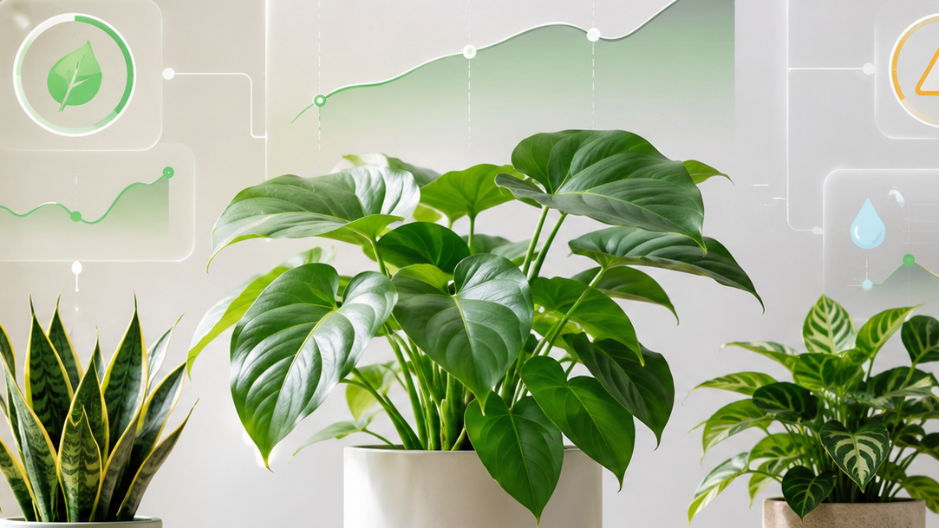
DASHBOARD & ANALYSIS
Progressive analysis, not overwhelming dashboards.
Generate Health Score
Generate Weekly Summary
Analyze Growth Trends
Analyze Environment Conditions
Check Health Risks
User benefit
Users can generate only the analysis they need, section by section.
LeafLogic • Plant Growth Intelligence & Decision Platform

Slide 9
TECHNOLOGY STACK
A modular full-stack architecture built for clarity and expansion.
Frontend
Backend
Database
React
Vite
CSS
Axios
React Router
FastAPI
SQLAlchemy
Pydantic
JWT Authentication
Password Hashing
SQLite
User model
Plant model
Plant log model
User-specific isolation
Architecture: Login & signup → Protected routes → Plant pages → Log forms → Trends & analysis dashboard → Contextual intelligence generation
LeafLogic • Plant Growth Intelligence & Decision Platform

Slide 10
TARGET USERS & IMPACT
Designed for practical plant care, learning and small-scale growing.
Home gardeners
Indoor plant owners
Balcony gardeners
Students
Agriculture hobbyists
Small nursery owners
Urban farming beginners
Better decisions
Understand care patterns before changing routines
Early warnings
Spot repeated pests, diseases and environment mismatch
Organized history
Keep growth, care, images and notes together
Beginner learning
Convert repeated logs into practical understanding
LeafLogic • Plant Growth Intelligence & Decision Platform

Slide 11
FUTURE SCOPE
A clear roadmap from tracking tool to plant-care intelligence platform.
01
More species profiles
02
Reminder system
03
Export plant reports
04
Multi-language support
05
Community care templates
06
Weather API integration
07
Mobile app version
The direction
LeafLogic can grow into a personal plant-care knowledge base built from real user history.
LeafLogic • Plant Growth Intelligence & Decision Platform

Slide 12
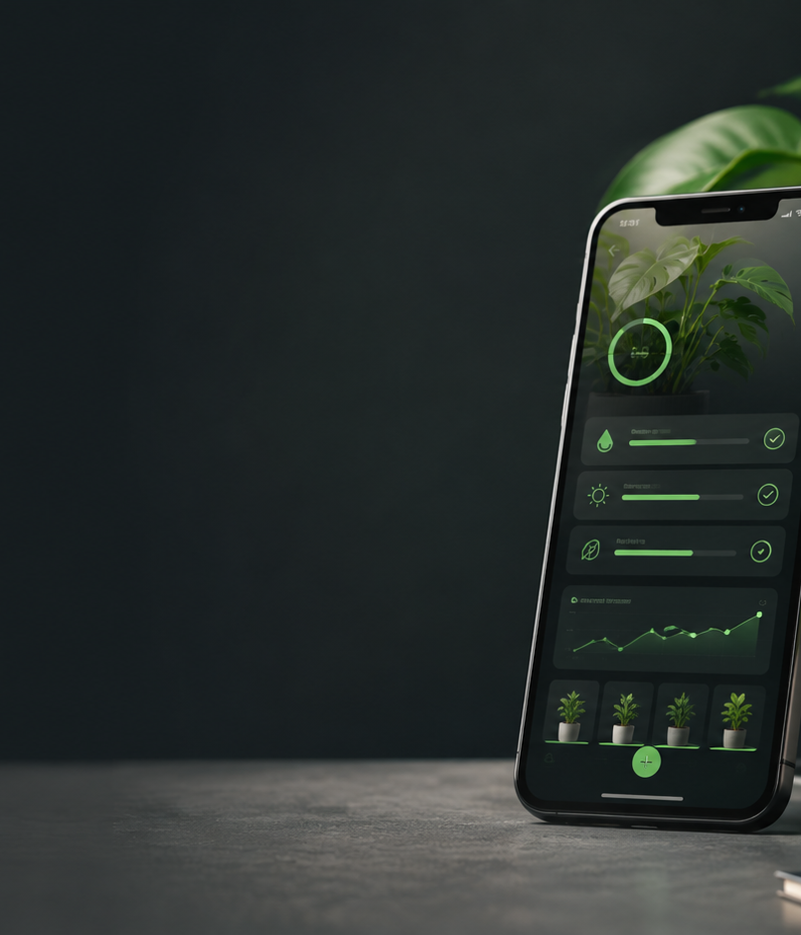
CONCLUSION
LeafLogic turns plant care from guesswork into intelligent, explainable decisions.
It helps users understand not just what happened to their plants, but why it happened and what to do next.
Plants cannot tell us what is wrong, but their data can.
Ready to validate with real growers.

